Slide 1

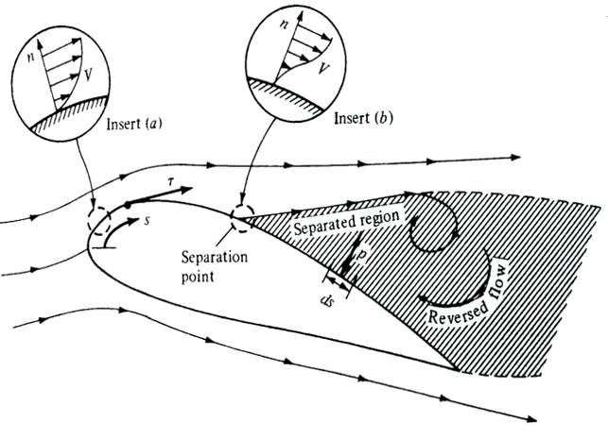
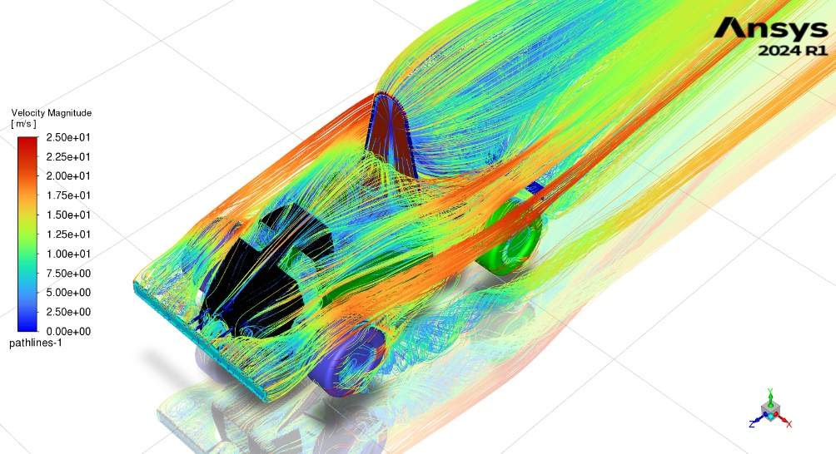
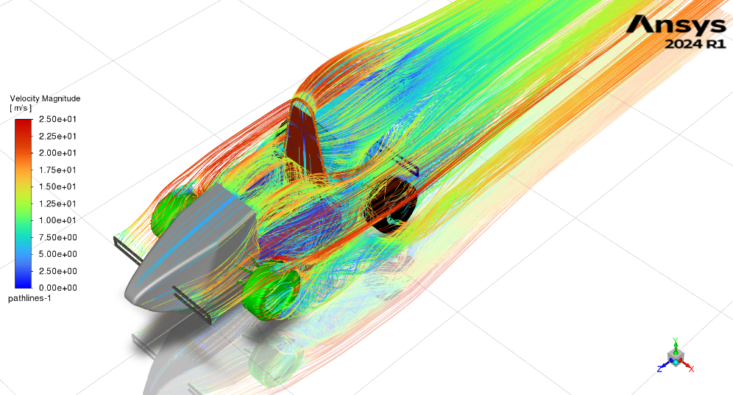
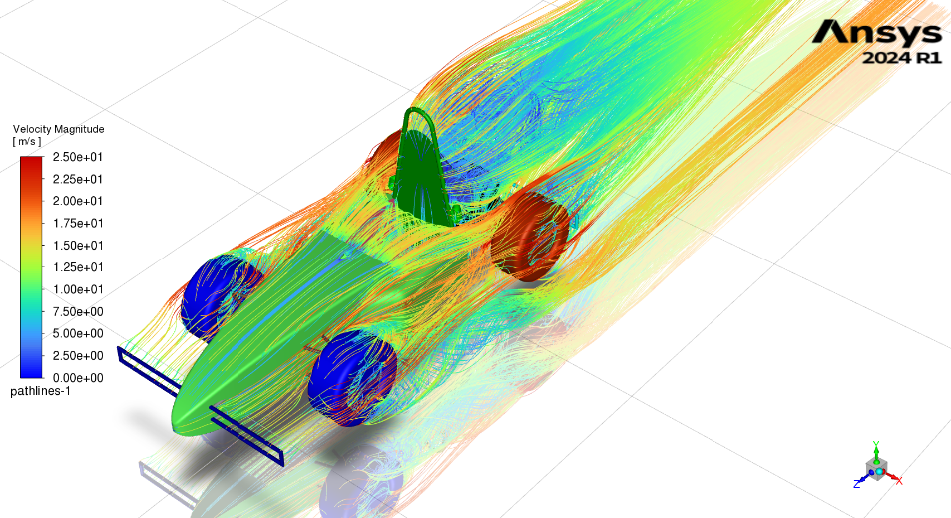
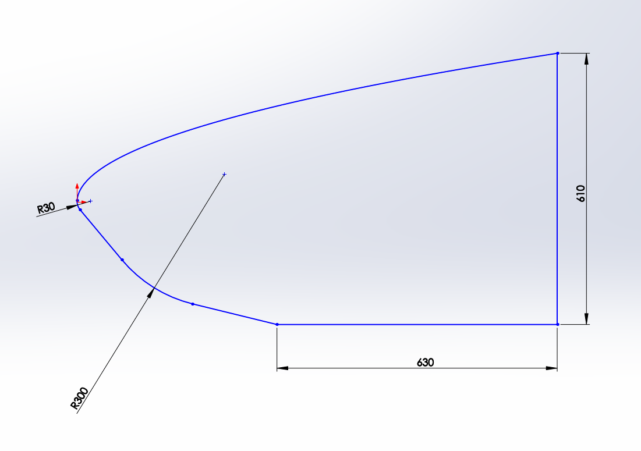
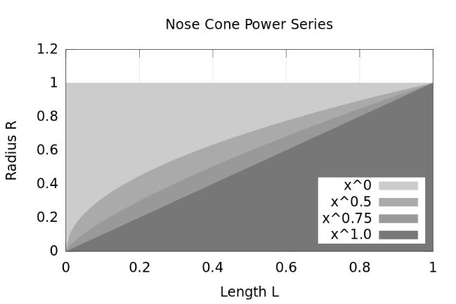
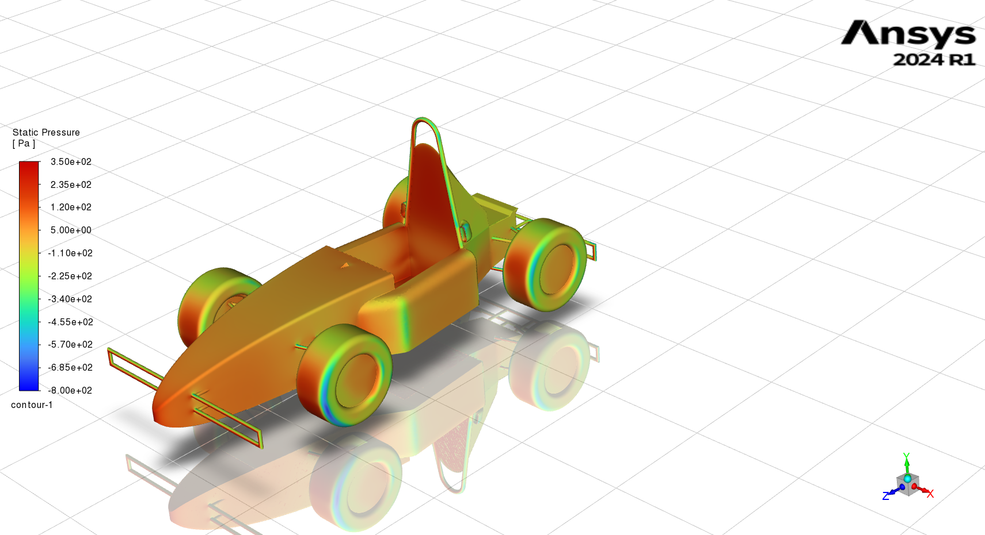
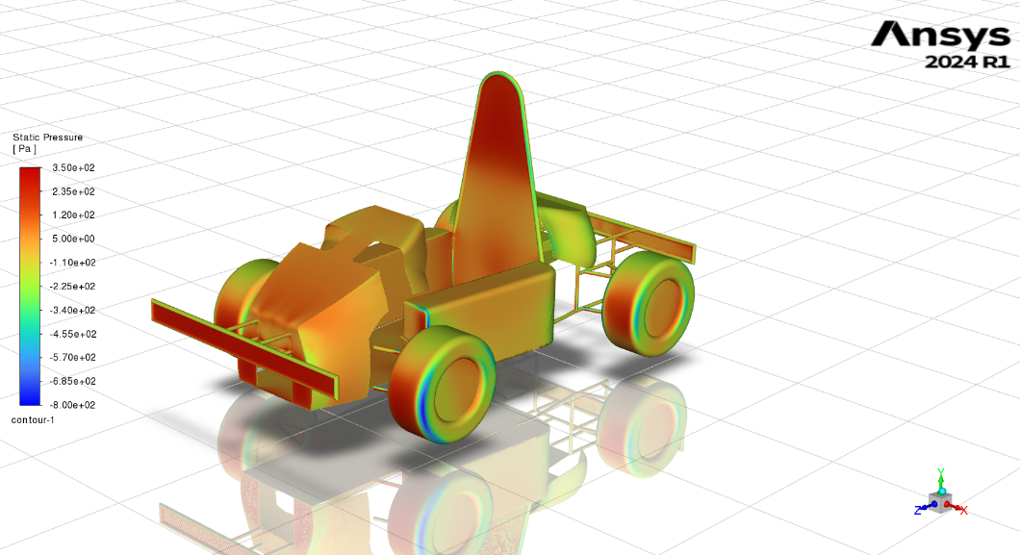
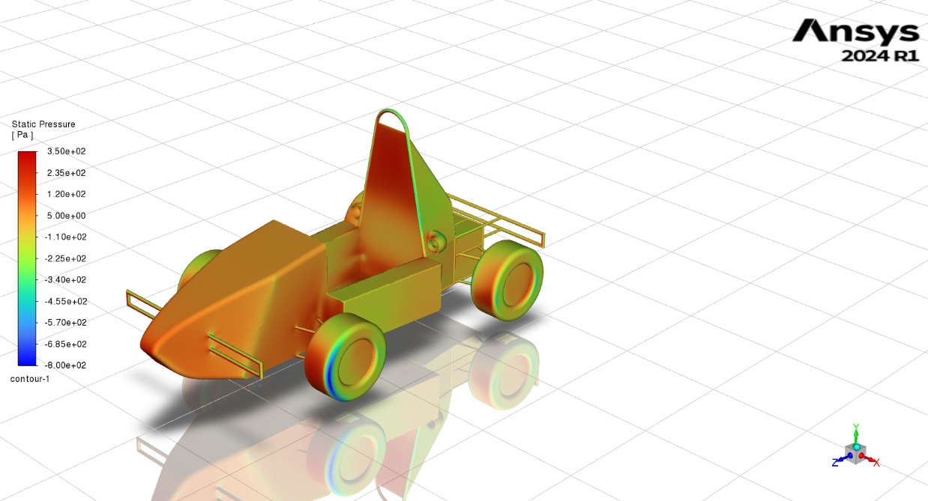
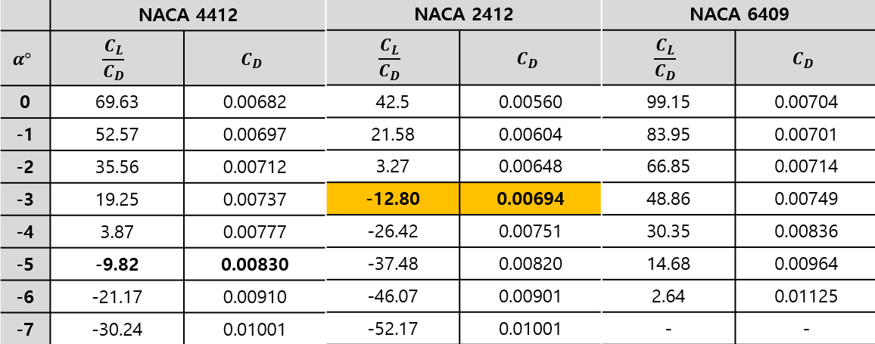
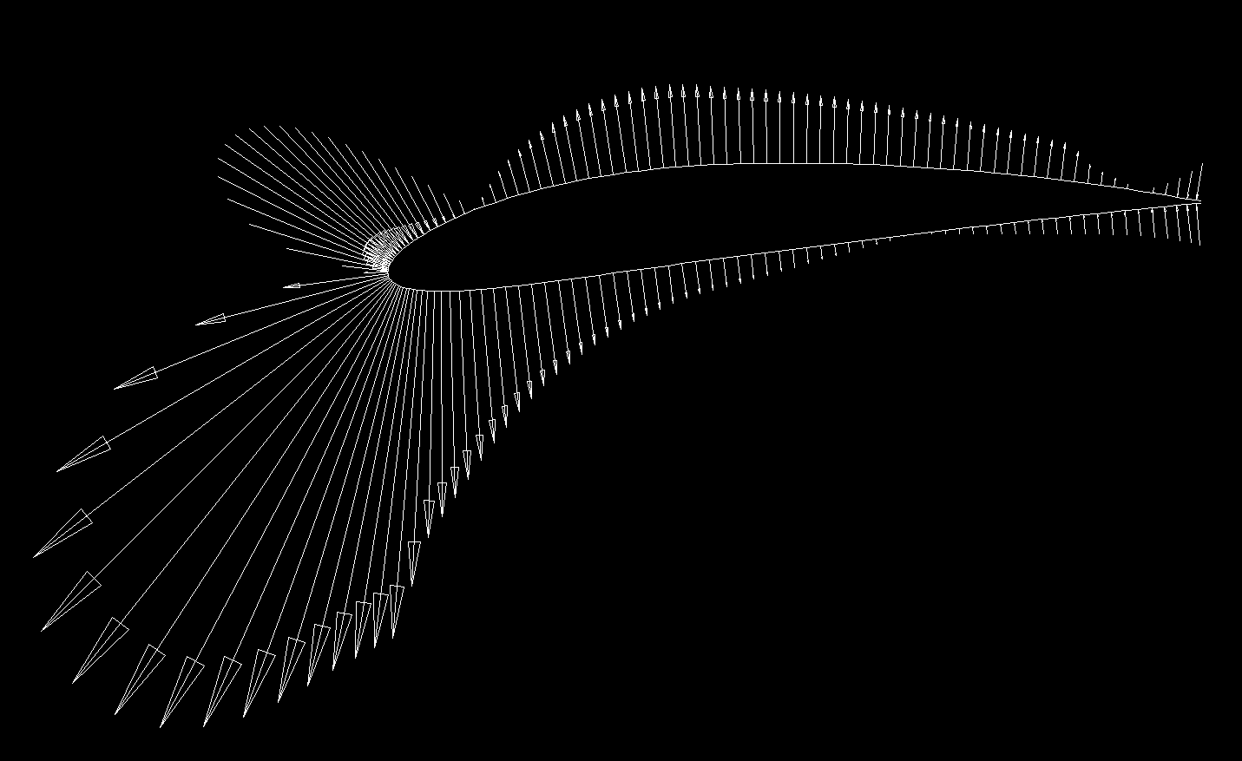
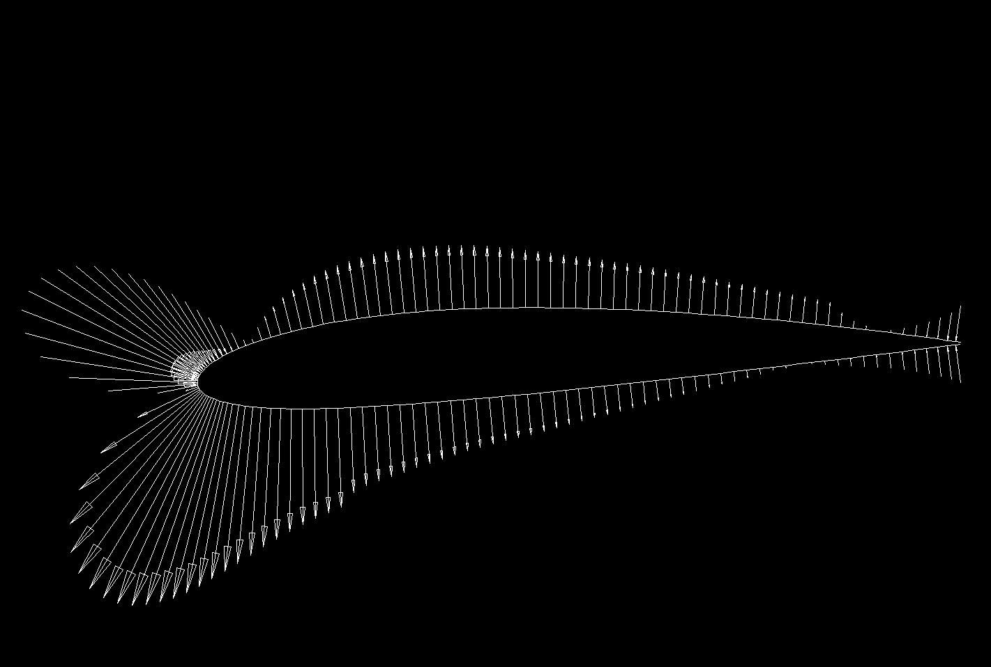
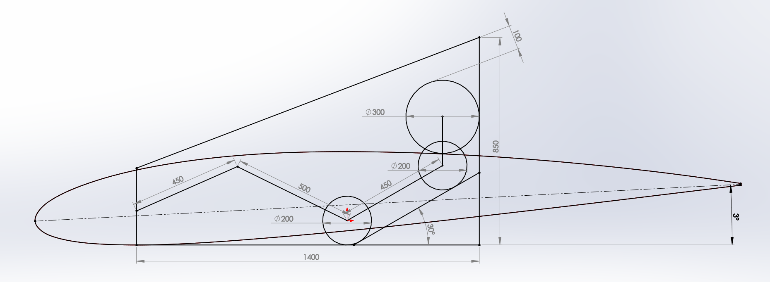
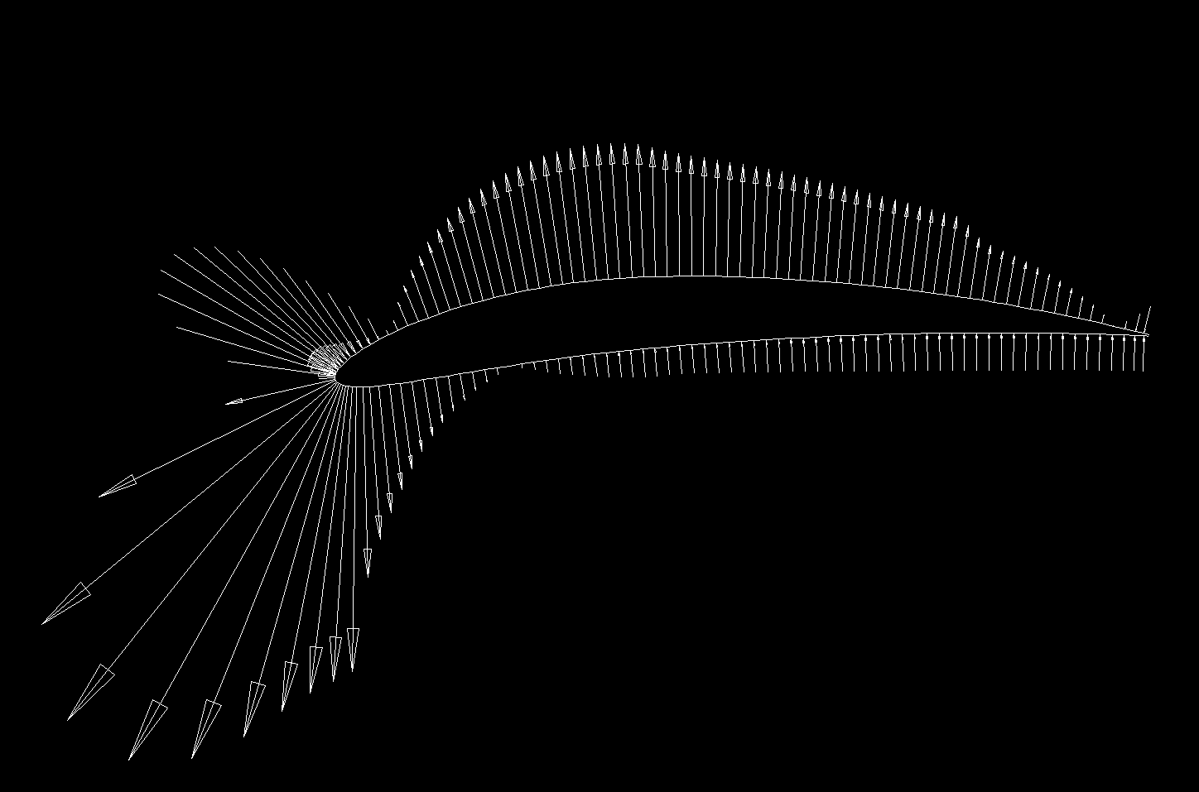
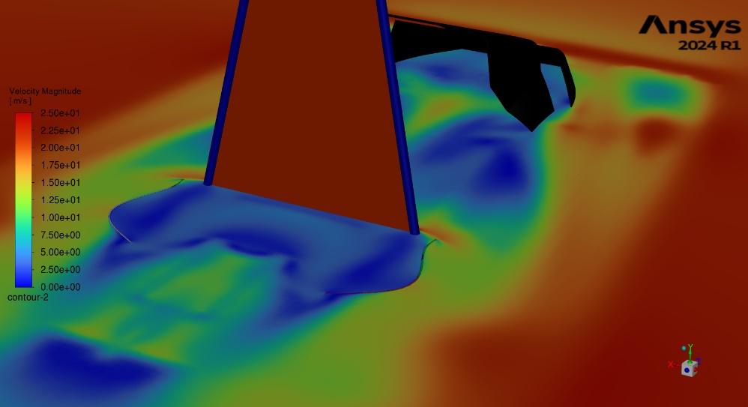
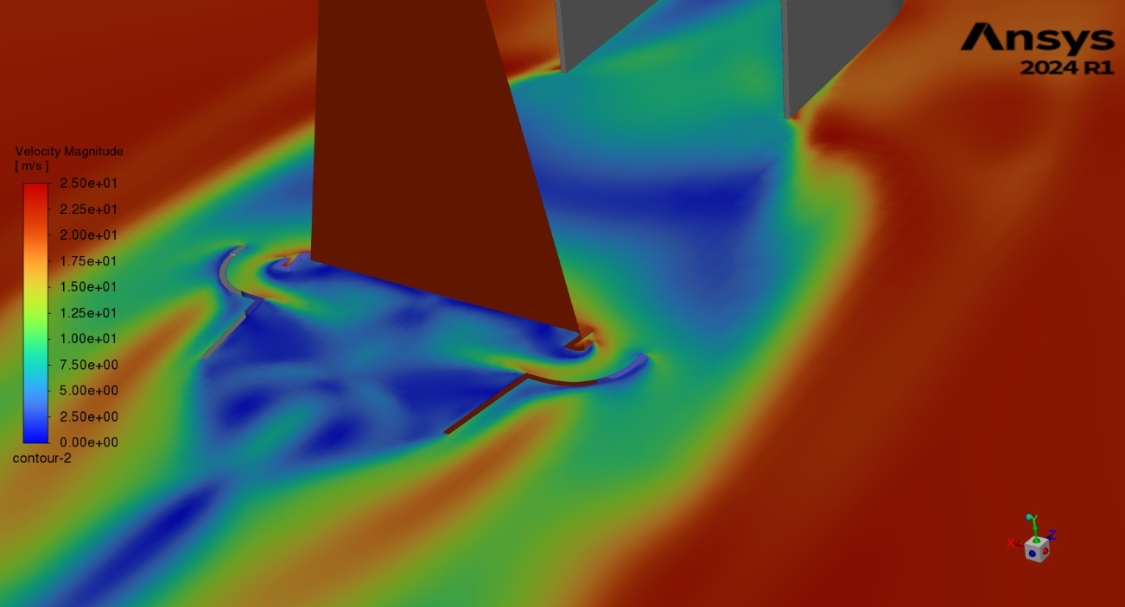
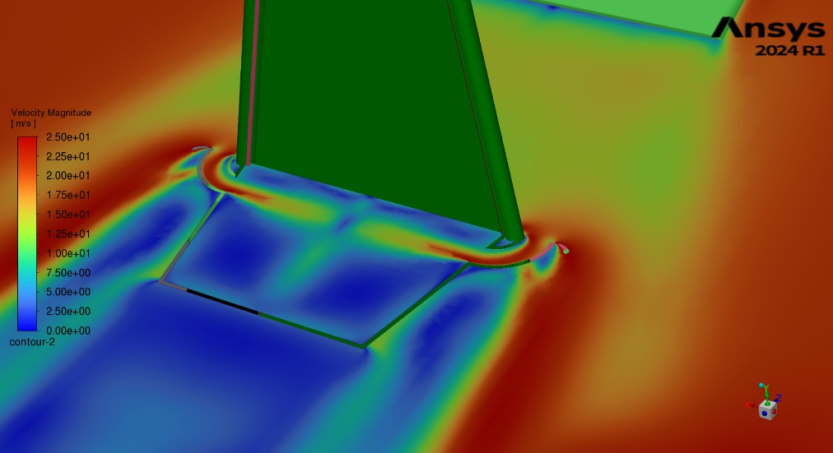
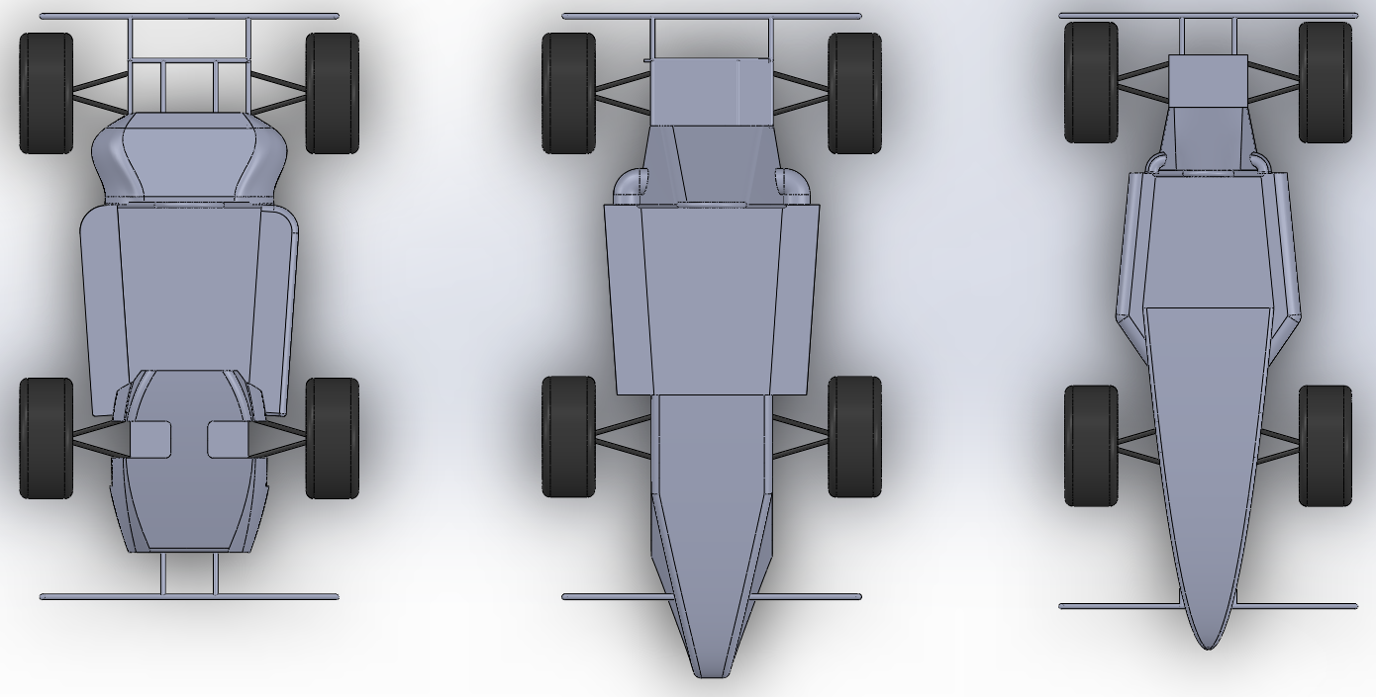
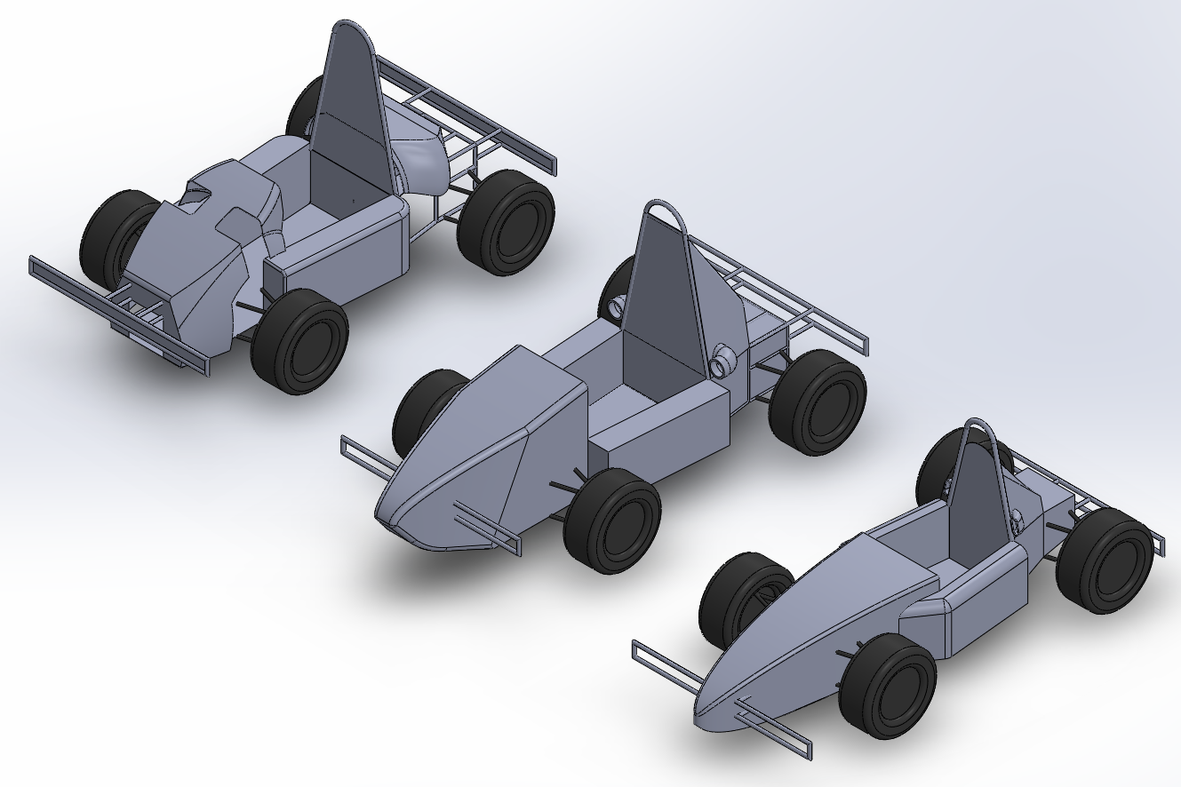
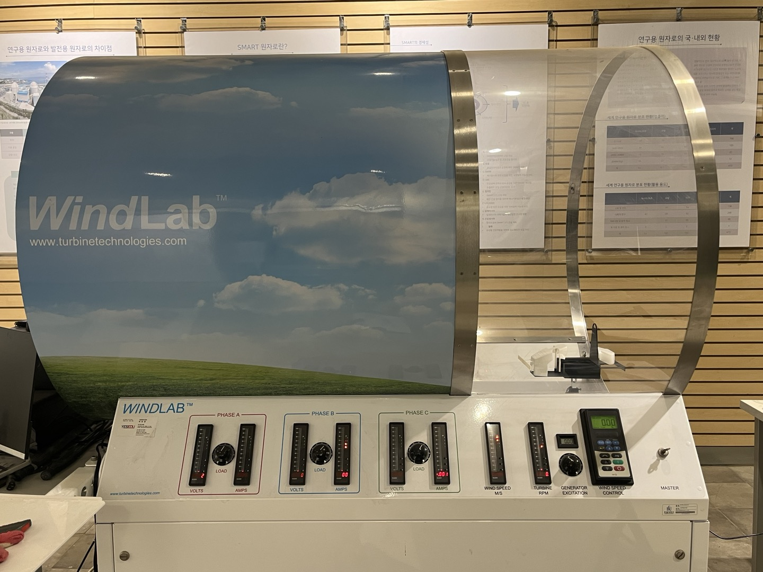
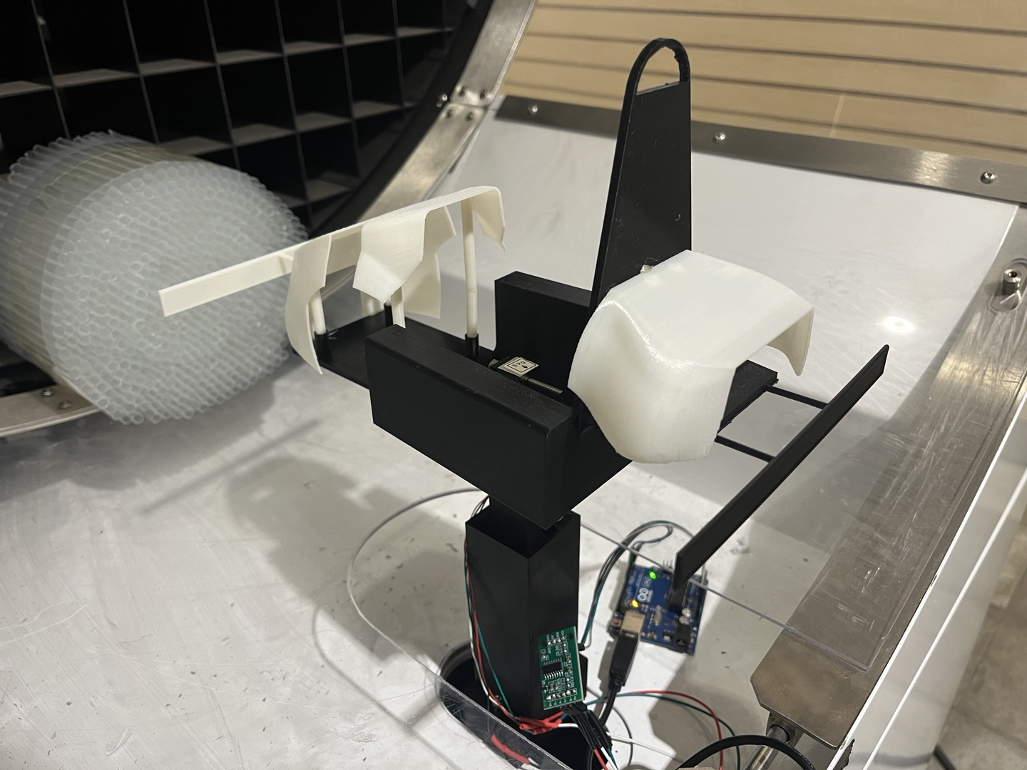
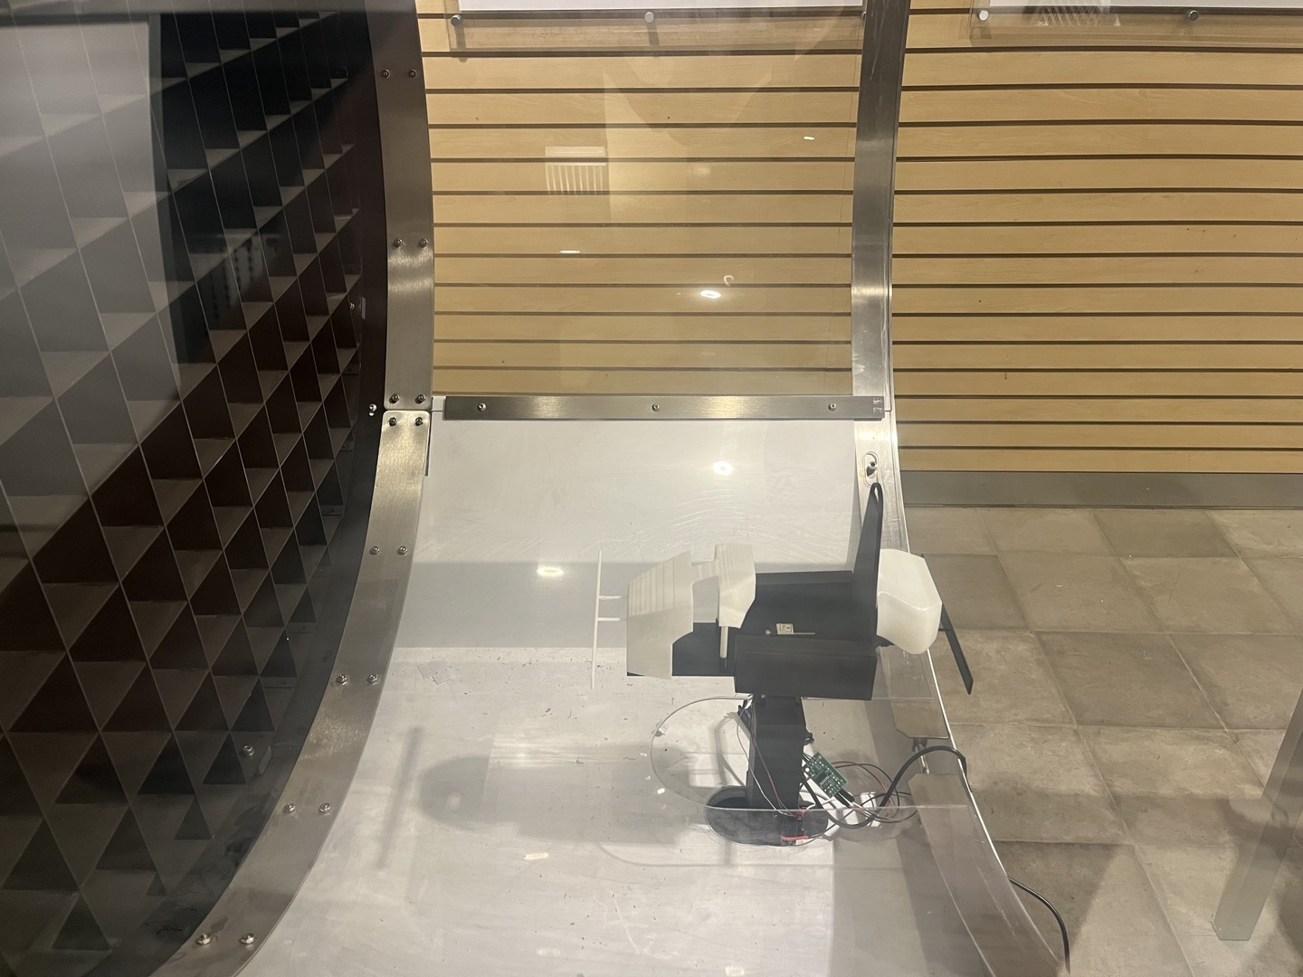
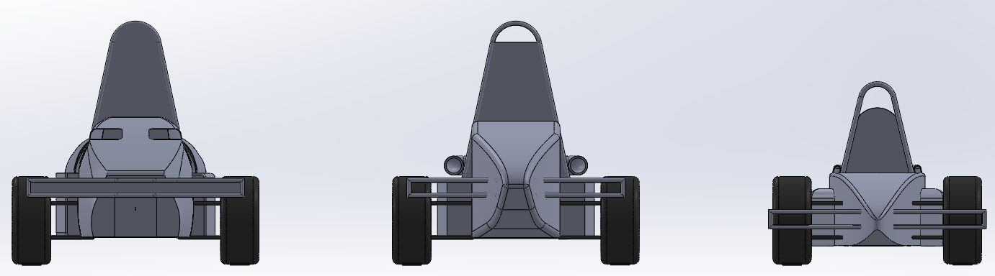
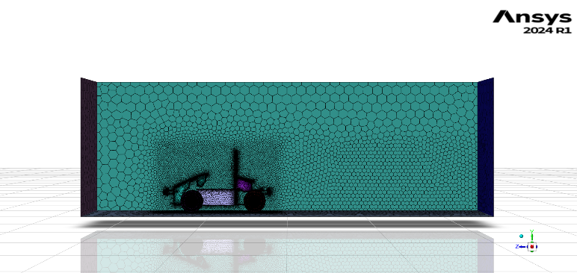
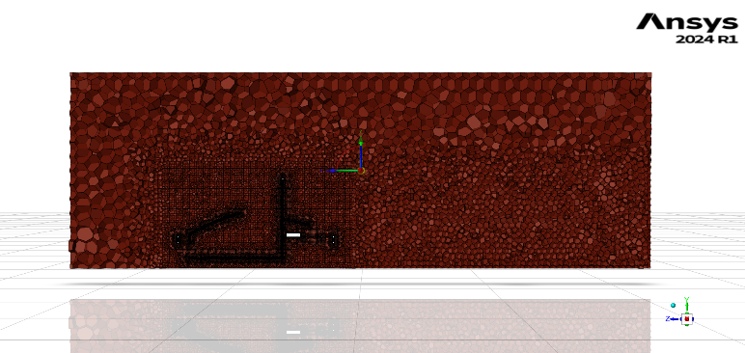
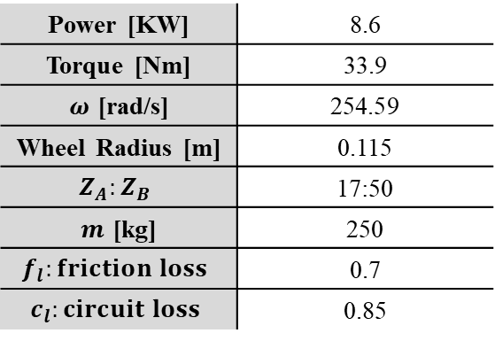
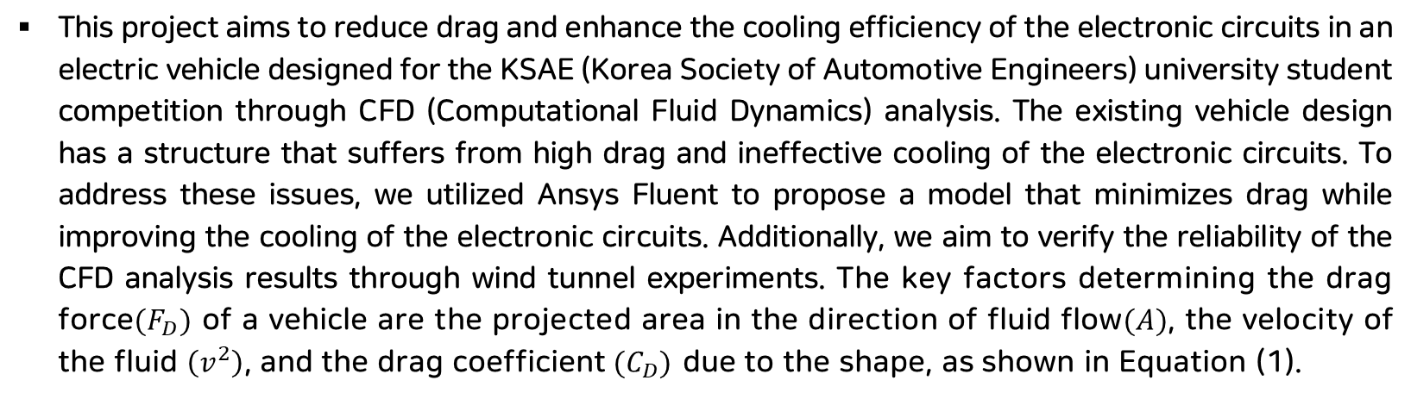
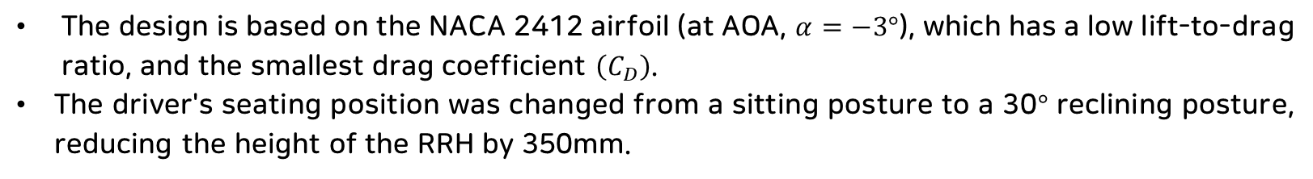
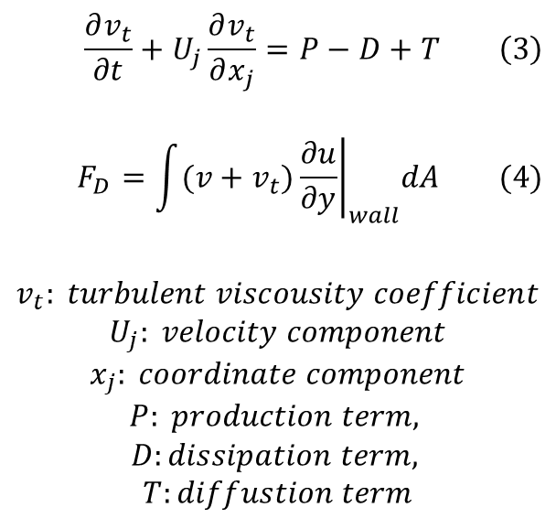
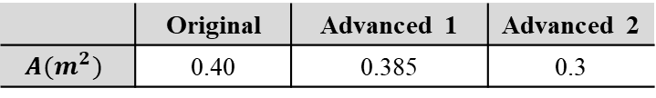
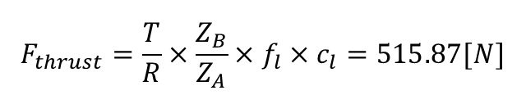
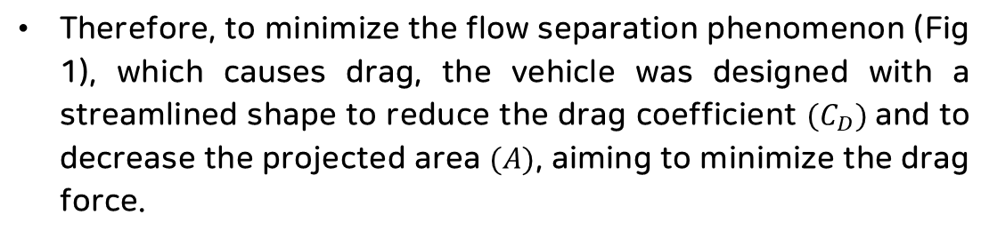
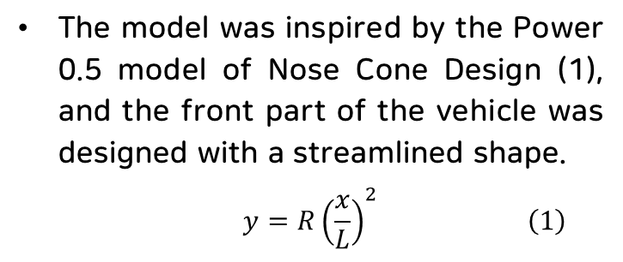
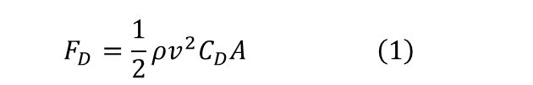
Optimal Design for Improving Drag and Cooling Performance of
KSAE E-Mobility through CFD Analysis
G. H. An, C. S. LEE
Handong Global University Mechanical Control Engineering
Introduction
Turbulence Model & Boundary Conditions
This project aims to reduce drag and enhance the cooling efficiency of the electronic circuits in an electric vehicle designed for the KSAE (Korea Society of Automotive Engineers) university student competition through CFD (Computational Fluid Dynamics) analysis. The existing vehicle design has a structure that suffers from high drag and ineffective cooling of the electronic circuits. To address these issues, we utilized Ansys Fluent to propose a model that minimizes drag while improving the cooling of the electronic circuits. Additionally, we aim to verify the reliability of the CFD analysis results through wind tunnel experiments. The key factors determining the drag force$(F_{D})$ of a vehicle are the projected area in the direction of fluid flow$(A)$, the velocity of the fluid $\left(v^{2}\right)$, and the drag coefficient$(C_{D})$ due to the shape, as shown in Equation (1).
Used Turbulence Model: Spalart-Allmaras (1-eqn)
Single Transport Equation -(3)
Suitable for External Boundary Layer Flow Analysis
Low Computational Cost
$$\frac{∂v_{t}}{∂t}+U_{j}\frac{∂v_{t}}{∂x_{j}}=P−D+T \left(3\right)$$
$$F_{D}=\int{{(v+v_{t})\left.\frac{∂u}{∂y}\right|}_{wall}dA (4)}$$
$$v_{t}: turbulent viscousity coefficient$$
$$U_{j}: velocity component$$
$$x_{j}: coordinate component$$
$$P: production term,$$
$$D:dissipation term,$$
$$T:diffustion term$$
Table 4. Boundary Conditions used in CFD Simulation
Type | Condition | Speed
Inlet | Velocity-Inlet | 20 [m/s]
Outlet | Pressure-Outlet | -
Cowl | Stationary-Wall | -
Frame | Stationary-Wall | -
Wheel | Rotational | 87.489 [rad/s]
Ground | Translational | -20 [m/s]
Tunnel-Wall | No Shear | -
$$F_{D}=\frac{1}{2}ρv^{2}C_{D}A \left(1\right)$$
Therefore, to minimize the flow separation phenomenon (Fig 1), which causes drag, the vehicle was designed with a streamlined shape to reduce the drag coefficient $(C_{D})$and to decrease the projected area $(A)$, aiming to minimize the drag force.
CFD Result (Drag Force)
Fig 1. Separation Phenomenon
Model Description
Advanced 1 (Frame Unmodified)
The model was inspired by the Power 0.5 model of Nose Cone Design (1), and the front part of the vehicle was designed with a streamlined shape.
$$y=R{\left(\frac{x}{L}\right)}^{2} \left(1\right)$$
Fig 2. Power 0.5 Nose Cone Design
Advanced 2 (Frame Modified)
Table 1. Lift-to-Drag Ratio and Drag Coefficient of NACA Airfoil at Different Angles of Attack
Fig 12. Velocity pathlines and Pressure Contour of Models
Fig 3. NACA 4412 $(α=−6°)$(XFOIL)
Advanced1 and Advanced2 reduced drag by 21.1% and 43%.
Drag Coefficient reduced by 17.7% and 21%.
RRH and front wheels caused the most drag, with vortices around wheels and rear.
Streamlined design reduced the drag coefficient.
Air vent drag did not significantly impact overall drag.
NACA 2412
Driver
RRH
Fig 4. NACA 2412 $(α=−3°)$(XFOIL)
Fig 13. Drag Force and Drag Coefficient
CFD Result (Cooling)
Fig 6. Advanced 2 Model Sketch (NACA 2412)
Fig 5. NACA 4412 $(α=−3°)$(XFOIL)
The design is based on the NACA 2412 airfoil (at AOA, $α=−3°$), which has a low lift-to-drag ratio, and the smallest drag coefficient $\left(C_{D}\right)$.
The driver's seating position was changed from a sitting posture to a 30$°$ reclining posture, reducing the height of the RRH by 350mm.
Electronic device
Electronic device
Electronic device
Fig 14. Rear Cowl Velocity Contour (Original, Advanced 1, Advanced 2)
Model Comparison
By adding an air vent shape, fast-flowing fluid through a narrow passage cools the electronic device with lower temperature fluid. ($2.5m/s→10m/s→16m/s)$
Fig 5. Original, Advanced 1, Advanced 2 Models (Up view)
Wind Tunnel Experiment Setting [Further Study]
2194mm
2513mm
2426mm
Air Vent
Honey Comb
Model
Fig 7. Original, Advanced 1, Advanced 2 Models (Top View)
Rodcell
MCU
Fig 9. Original, Advanced 1, Advanced 2 Models (Left to Right)
Amplifier
Table 2. Projected Area of Models
Fig 15. Wind Tunnel Experiment Settings
Fig 8. Original, Advanced 1, Advanced 2 Models (Front View)
 | Original | Advanced 1 | Advanced 2
$$A(m^{2})$$ | 0.40 | 0.385 | 0.3
Uniform fluid flow is formed after passing through the honeycomb.
The model's air resistance deforms the rod cell, changing its electrical resistance
The amplified signal is sent to the MCU to calculate drag.
The drag coefficient is calculated using the anemometer's fluid velocity and atmospheric conditions, and compared with simulation results
Meshing Method
Table 3. Mesh Conditions
Discussion & Conclusion
Region | Type | Size (mm)
BOI-nearfield | Body of Influence | 40
BOI-farfield | Body of Influence | 90
Bumper and Rods | Curvature | Min:4 / Max:5
Cowl | Curvature | Min:5 / Max:30
Wheel | Curvature | Min:3.5 / Max: 5
Boundary Layer | Last-ratio | 10 layers / Ratio: 0.2
Surface | Curvature & Proximity | Min: 0.5 / Max: 256
Volume | Poly-hexcore | Min: 0.5 / Max: 512
z
Table 5. DIY Car Spec Sheet
The reduced drag (105[N]) is significant compared to the drive force (515.87[N]) from Table 4.
Reduced drag can improve top speed and acceleration.
Drag is proportional to the square of speed, so reducing the projected area and drag coefficient reduces drag.
Safety device (RRH) regulations limited drag coefficient reduction (1.25 → 0.98).
Adding air vents improved cooling and motor efficiency.
Running time: 90min. Proper geometry and mesh generation are crucial (16-core process, 2.9 million cells).
Power [KW] | 8.6
Torque [Nm] | 33.9
$ω$ [rad/s] | 254.59
Wheel Radius [m] | 0.115
$$Z_{A}:Z_{B}$$ | 17:50
$m$ [kg] | 250
$$f_{l}:friction loss$$ | 0.7
$$c_{l}:circuit loss$$ | 0.85
Fig 10. Mesh Convergence
$$F_{thrust}=\frac{T}{R}×\frac{Z_{B}}{Z_{A}}×f_{l}×c_{l}=515.87[N]$$
Fig 11. Surface Mesh (Left), Volume Mesh (Right)

